Slide 1
IS590DT: Data Mining Applications WEEK 7: Clustering
Spring 2019
Yingjun Guan
yingjun2@illinois.edu
http://ischool.illinois.edu/people/yingjun-guan

Slide 2
First things first.
Survey results on projects …
Assignments 3 & 4.

Slide 3
Previously on …
Questions: If I want to do the document classification of author genders based on stylometry, what should I do?
RQ (What assumptions you might hold?)
Data (what makes it a good dataset)
EDA (what makes it a bad dataset)
Preprocessing (NLP)
Classification (what model do you prefer)
Evaluation (how do you know it is a good one)

Slide 4
Difference between clustering and classification.
What’s the difference between classification and clustering?
Classification
vs
Clustering
Labeled vs unlabeled
Learn vs apply (predict)
Other ideas...

Slide 5
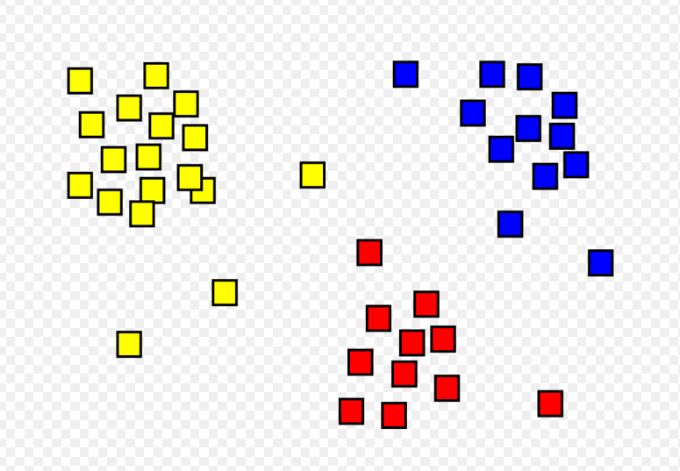
Today, let’s talk about clustering.
Seriously, what is clustering?
Discuss with your neighbor, and write down the definition of clustering in your own words.

Slide 6
Today, let’s talk about clustering.
Seriously, what is clustering?
Clustering: group objects into subsets, such that objects within each subset are more similar to one another than objects assigned to different clusters.

Slide 7
What is clustering?
How to turn clustering into a math problem.
Goal: group objects into subsets, such that objects within each subset are more similar to one another than objects assigned to different clusters.
What is “similar”?
How to measure similarity?
--> Distance!

Slide 8
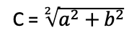
1. In geometry.
Dissimilarity Measures in different situations.
Euclidean Distances d(x,z)
Who’s Eucilid?
What’s Eucilidean distance?
How to write them down in math?
<encourage participation on blackboard>
C = $\sqrt[2]{a^{2}+b^{2}}$

Slide 9
1. In geometry.
Dissimilarity Measures in different situations.
Why Euclidean Distances help?
The feature of d(x; z):
d(x; z) >= 0
d(x; z) = 0 if and only if x = z
d(x; z) = d(z; x)
d(x; y) <= d(x; z) + d(z; y) (triangle inequality)
C = $\sqrt[2]{a^{2}+b^{2}}$

Slide 10
1. In geometry.
Dissimilarity Measures in different situations.
Give me some examples when Euclidean distance doesn’t work.
Non-Euclidean Distances d(x,z)
What’s that mean?
In what situation?
How to calculate?
C = $\sqrt[2]{a^{2}+b^{2}}$

Slide 11
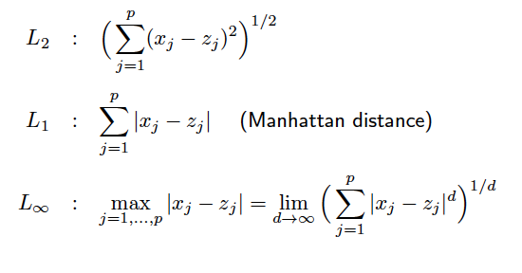
How to express Euclidean distance in math
L₁ norm; L₂ norm; L_{$\inf$} norm

Slide 12
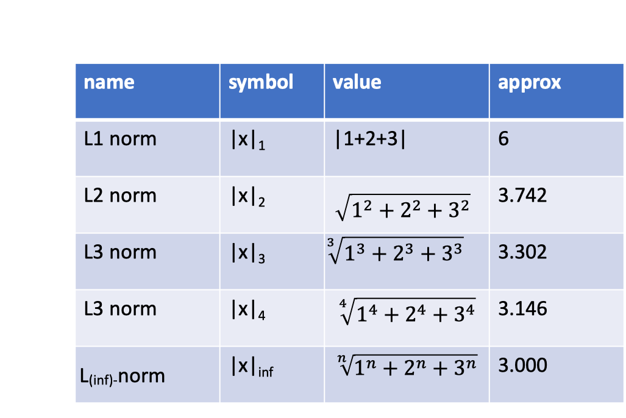
Let’s take an example.
Distance to a point v(1,2,3).

Slide 13
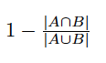
2. In unordered sets.
Dissimilarity Measures in different situations.
What’s the distance between the following sets?
{A;C;D;E} and {A;D;E}
How to define the distance here? (Jaccard Distance)
Other applications?
Jaccard distance could also measure distance between sentences based on the words and even movies/restaurants based on their ratings.

Slide 14
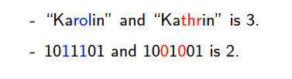
3. In string sets.
Dissimilarity Measures in different situations.
Hamming distance between two strings (of the same length): number of positions at which the corresponding symbols are different.
Other applications?
Although the length are the same, you could think about distance between texts, DNA, and Protein sequences!

Slide 15
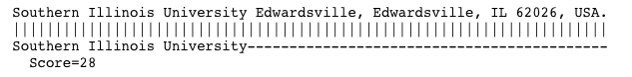
4. Sequential edit distance.
Dissimilarity Measures in different situations.
What’s the distance from “banana” to “Canada” in the idea of editing?
Edit distance: number of inserts and deletes to change one string into another.
Other applications include protein detection, <cancer diagnostic>; text mining <named entity recognition>; etc.

Slide 16
Other examples
The most important thing in clustering is how you define the distance, which is more important than how you do the clustering. And the way you define can dramatically influence the clustering results. Remember to explain the clustering results.
Now, let’s do some brainstorming on real projects…

Slide 17
Shopping example.
{apple, pineapple, towel, banana, beer, strawberry, blueberry, diaper, book, ruler, helicopter, baby}
What distance should I apply if I want to cluster {apple, pineapple, banana, strawberry, blueberry} together?

Slide 18
Shopping example.
{apple, pineapple, towel, banana, beer, strawberry, blueberry, diaper, book, ruler, helicopter, baby}
What distance should I apply if I want to cluster {strawberry, blueberry, -{banana, apple}} together?

Slide 19
Shopping example.
{apple, pineapple, towel, banana, beer, strawberry, blueberry, diaper, book, ruler, helicopter, baby}
What distance should I apply if I want to cluster {beer, diaper} together?

Slide 20
Words example
Set: in the dictionary set.
What distance should I apply if I want to cluster {happy, energetic, achievement} together?

Slide 21
Words example
Set: in the dictionary set.
What distance should I apply if I want to cluster {unisex, universal, unicorn} together?

Slide 22
Words example
Set: in the dictionary set.
What distance should I apply if I want to cluster {Mississippi, Swiss, schistous} together?

Slide 23
Now that’s change the question.
What distance should I apply if I want to cluster {Set} together?
->
If I assume there’s a factor of X, how would I define the distance to do the clustering?

Slide 24
Time series example
If I assume there’s a factor of US politics, how would I define the distance to do the clustering?
Threshold – distance?
Election period?
The duration since Act X is passed

Slide 25
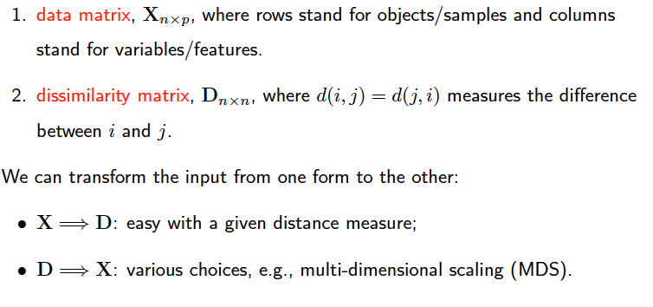
Two Types of Inputs for Clustering
people | height | weight | salary
a | x | x | x
b | x | x | x
c | x | x | x
Distance | a | b | c
a | d | d | d
b | d | d | d
c | d | d | d

Slide 26
Two Types of Inputs for Clustering
Example and the transformation
people | Height (cm) | Weight (kg) | Salary(*1000$/year)
a | 171 | 80 | 60
b | 195 | 90 | 200
c | 153 | 70 | 250
Distance | a | b | c
a | ? | ? | ?
b | ? | ? | ?
c | ? | ? | ？
D
X
Hint: Let’s take L-1 Norm Distance.
X->D? D->X?
Notes:
X->D

Slide 27
Two Types of Inputs for Clustering
Example;
Problems in transforming;
Why we need these two;
R application – save it to Kmeans.
people | height | weight | salary
a | x | x | x
b | x | x | x
c | x | x | x
Distance | a | b | c
a | d | d | d
b | d | d | d
c | d | d | d

Slide 28
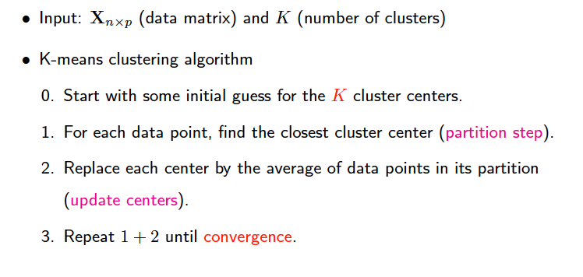
K-means Clustering
KMeans

Slide 29
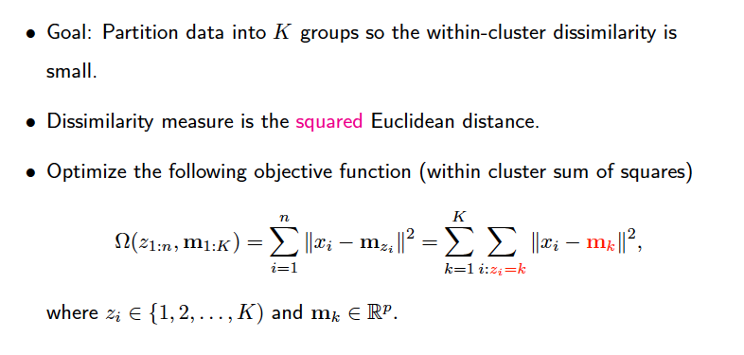
Tips on KMeans
KMeans

Slide 30
KMeans
Quiz:
Given dataset A(1,1), B(2,0), C(3,0), D(5,5), E(7,5), F(4,6).
Initial seed X(0,0), Y(3,2).
Question:
In round 1: who’s in Class X? Who’s in Y?
What’s the centroid for round 2?
Hint: plot the dots in coordinates.

Slide 31
KMeans
R-application

Slide 32
Some issues.
The seed influence
Computation cost of Kmeans
How to improve the K-Means
How to choose K

Slide 33
The seed influence
How are the seed selection influence the clustering results?
How to fix it?
Check ‘nstart’ in R!

Slide 34
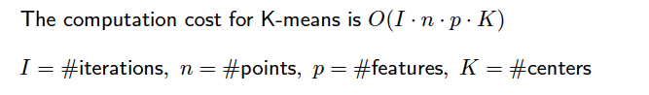
Computation cost and how to reduce it
What factor will influence the cost for KMeans?
How to improve?
Reduction: feature selection methodologies.
Eg: PCA, SVD, random projection, etc.

Slide 35
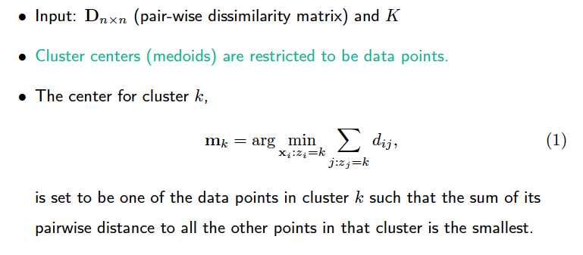
How to improve Kmeans? Kmedoids!
Why do we need K-Medoids?
Categorical data
Complexity

Slide 36
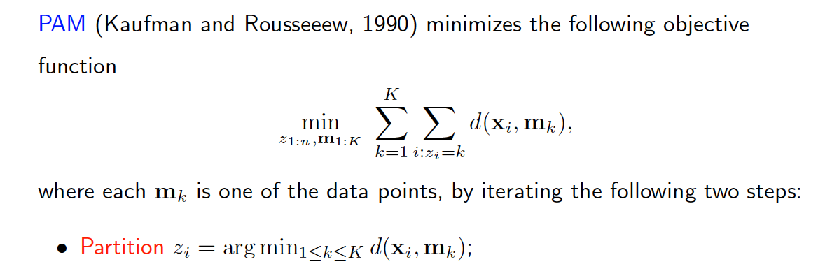
Partition Around Medoids (PAM)
Model and R application.

Slide 37
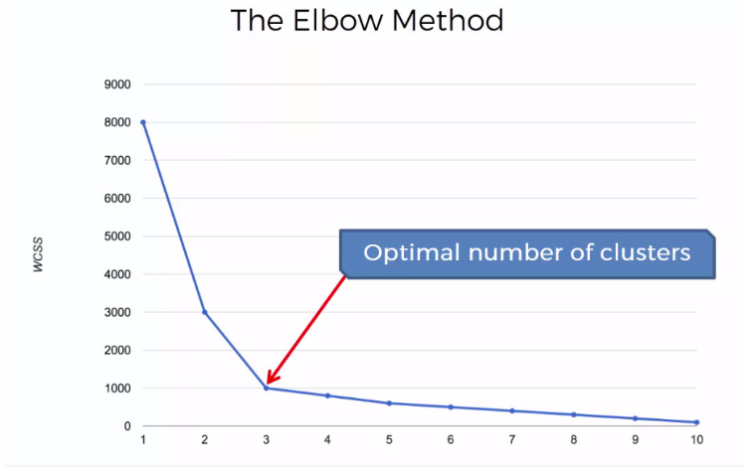
How to select K?
Elbow point.

Slide 38
Application
Demonstrate Yingjun’s poster.

Slide 40
After class…
Assignment 5.
Reading.

